Slide 1

Marketing
Campaign Effectiveness
By: Youssra Abouzaid

Slide 2
01
02
TABLE OF CONTENTS
03
04
Hotel Business Problem
Dashboard, and overview
Summary
Limitations
05
Recommendations

Slide 3
Hotel Business Problem
Anjum Hotel has been running various marketing campaigns to increase room bookings and enhance brand visibility. Despite investing significantly in these campaigns, the hotel management is unsure which channels yield the highest return on investment (ROI) and which campaign strategies are most effective. They want to optimize their marketing spend and maximize bookings and revenue.
Objective
To analyze the effectiveness of different marketing campaigns and channels, determine which ones drive the most bookings and revenue, and provide data-driven recommendations to optimize future marketing efforts.

Slide 4
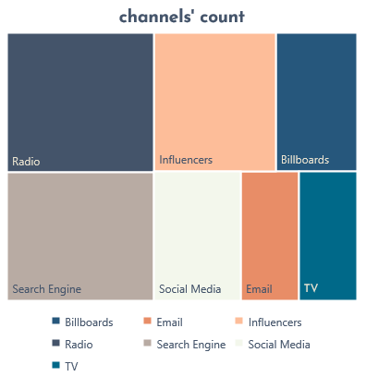
Marketing Campaign Effectiveness
AVG campaigns days
Total Revenue
Total bookings
19
Campaigns number
$2,188,103
Channels number
50
7
252,112

Slide 5
Marketing Campaign Effectiveness

Slide 6
Marketing Campaign Effectiveness
This graph illustrating the data from the table would depict the Return on Investment (ROI) percentage for each marketing channel. The TV has the highest ROI at 594%, The shortest bar would be for Email at 20%.

Slide 7
Bookings per audience
Dashboard overview
2024
Has 33,950 more bookings than the last year
2023
Has 109,081 total bookings number
This graph represents the total number of bookings per target audience category for the years 2023 and 2024. In 2024 the highest number of bookings came from the 'Young Adults' audience segment. In 2023, the trend shifts, and the 'Seniors' audience segment records the highest number of bookings.

Slide 8
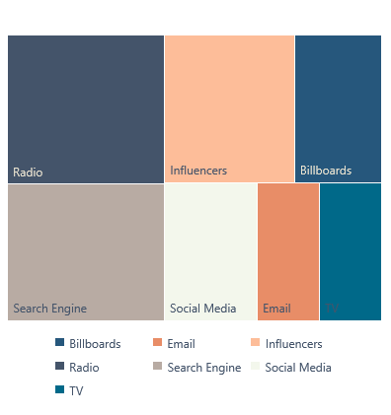
Channel’s count
Dashboard overview
This tree map visualizes the utilization of different marketing channels based on their usage counts. Each rectangle in the tree map represents a specific channel, with the size of the rectangle corresponding to the number of times that channel was used in marketing campaigns. The largest rectangle in the tree map represents 'Radio', indicating that it is the highest-used channel. The smallest rectangles correspond to 'Email' and 'TV' channels, showing that these are the least used channels.

Slide 9
Dashboard overview
This bar chart compares the number of clicks and bookings generated by various marketing channels. The Search Engine channel generates the highest number of clicks among all channels, with a substantial amount of user engagement. However, the conversion rate to bookings is relatively low compared to the number of clicks. Radio channel generating a substantial number of bookings, there are no clicks.

Slide 10
Revenue per audience
Dashboard overview
Families
943,005$ 43%
Bussiness travelers
471,838$ 22%
Young Adults
390,124$ 18%
The target audience, families with the highest revenue of $943,005, represents 43% of the total revenue The target audience, seniors with the lowest revenue of $383,136, represents 17% of the total revenue
Senior
383,136$ 17%

Slide 11
Dashboard overview
This graph illustrates the distribution of campaigns by month: November 2023 recorded the highest number at 7 campaigns, while October 2023 and May 2024 each had the lowest at 1 campaign.

Slide 12
Revenue VS. Spend per channels
Dashboard overview
Spend
Amount spent on each channel
Revenue
revenue generated from each channel
This graph displays the expenditures and revenue for each channel. While the search engine channel has the highest spending, TV yielded the highest revenue.

Slide 13
Dashboard overview
This graph displays the total number of days per channel. The radio channel has the highest number of days per campaign, while Email has the fewest.

Slide 14
Summary
The TV channel boasts the highest ROI among all marketing channels.
In 2024, revenue and bookings reached their peak.
Radio is the most frequently used channel and has the longest campaign duration.
Search Engine channel: High clicks and user engagement, but low booking conversion rate.
Radio channel: Generates substantial bookings without reported clicks.
The target audience, families, generates the highest revenue.
The highest number of campaigns was in November 2023.
The TV channel has the highest revenue, while the search engine channel has the highest expenditure.

Slide 15
Limitations
Campaign durations vary widely, from 10 days to 28 days, This variability can make it challenging to compare the effectiveness of campaigns directly.
Different audiences might respond differently to various channels, complicating direct comparisons.
The campaigns are run in different months, seasonal variations can influence the performance of campaigns, making it harder to compare them directly.
Some campaigns have high impressions but zero clicks recorded, this discrepancy suggests potential issues in tracking user interactions accurately.
ROI is calculated as a simple percentage without considering other performance metrics such as customer lifetime value or brand awareness.

Slide 16
Recommendations
For channels like Radio and Billboards, where clicks are zero, ensure there's a mechanism to track engagement accurately.
Based on ROI, channels like TV, Influencers, and Social Media are yielding higher returns. Allocating more budget to these channels can potentially improve overall campaign performance.
Continuously test different creatives, messages, and targeting strategies to identify the most effective combinations.
While some campaigns targeting Young Adults (e.g., Campaigns 4, 24, 27) have lower ROI, others (e.g., Campaigns 10, 30, 49) are performing well. Analyzing the successful campaigns to understand what works (e.g., channel, content, timing) and replicating these factors in other campaigns targeting the same demographic might be beneficial.
Complement billboard advertising with digital campaigns (e.g., geotargeted mobile ads) to enhance visibility and track engagement better.

Slide 17
Recommendations
Improve email content with personalized messages, attractive subject lines, and clear calls to action. Segment your audience to tailor the content more effectively.
For search engines optimize keywords and ad copy. Focus on high-performing keywords and consider excluding low-performing ones. Use ad extensions to improve visibility and click-through rates.
Continue investing in social media ads, particularly for campaigns targeting Young Adults and Business Travelers. Utilize advanced targeting options to reach specific demographics more effectively.
Increase collaboration with influencers, especially for campaigns targeting Young Adults and Business Travelers. Select influencers whose followers align well with your target audience.
Maintain a balanced investment in TV ads for broad reach. Use TV ads to build brand awareness and complement with digital channels for targeted engagement.

Slide 18
Thanks

